Slide 1
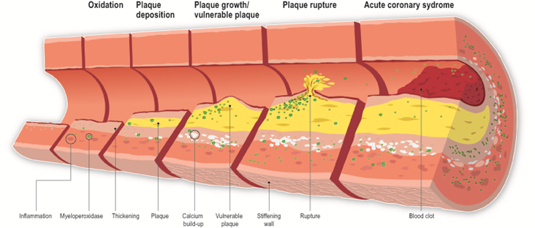
CardioVascular Disease
Measure, track and improve with medical ultrasound machines. Inflammation and plaque can be tracked and improved. The sum of all risk factors is evident at the end-organ for CV disease.

Slide 2

Vasolabs is a nationally known, mobile ultrasound company.

Slide 3

After a year, patients who viewed ultrasound pictures of their vascular damage halved their CV risk compared to the control population.
VIPVIZA Study, The Lancet, Vol 393 January 12, 2019. Reprints available.

Slide 4
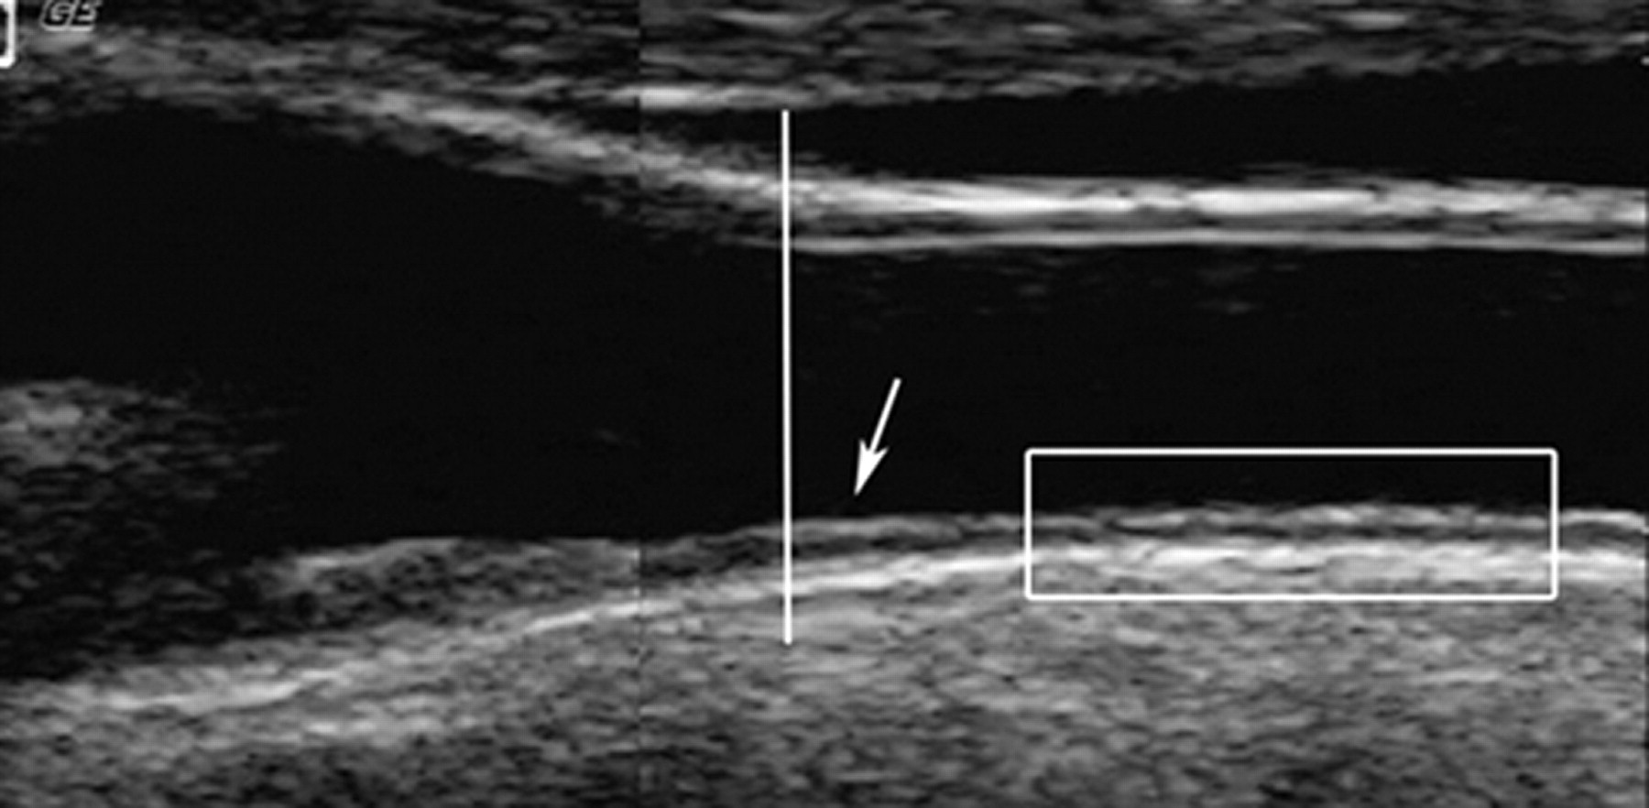
Location of Ultrasound Measurement

Slide 5
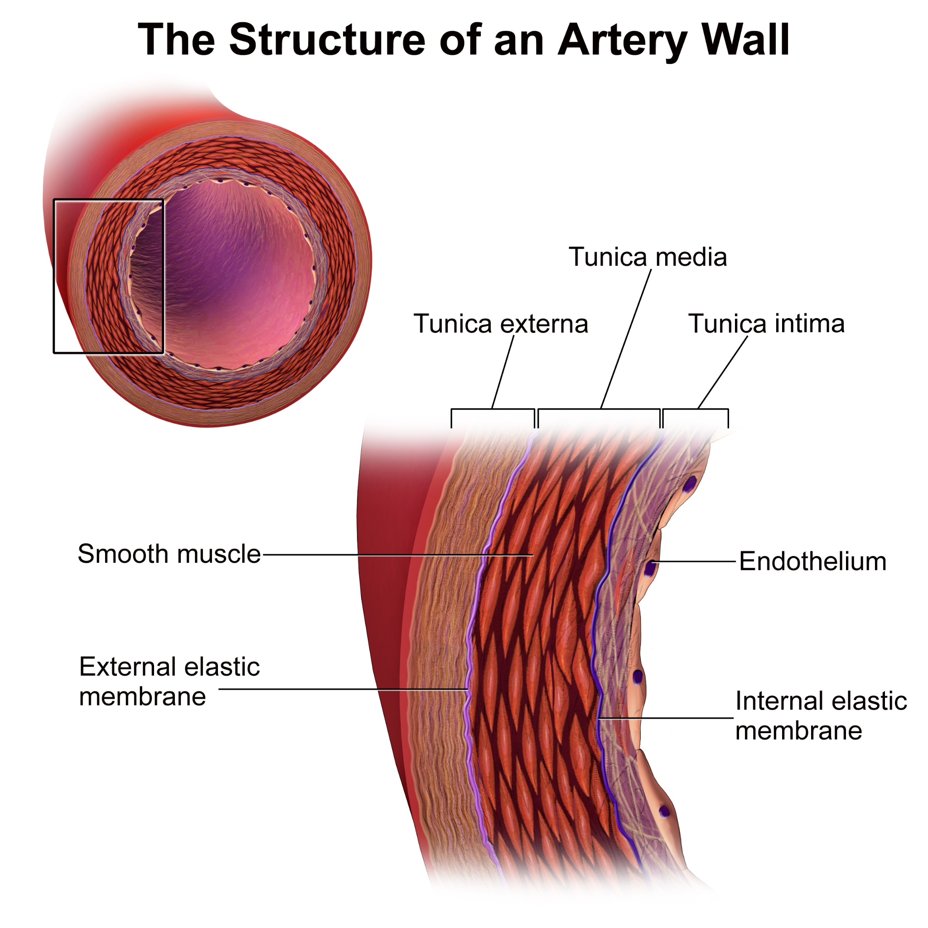
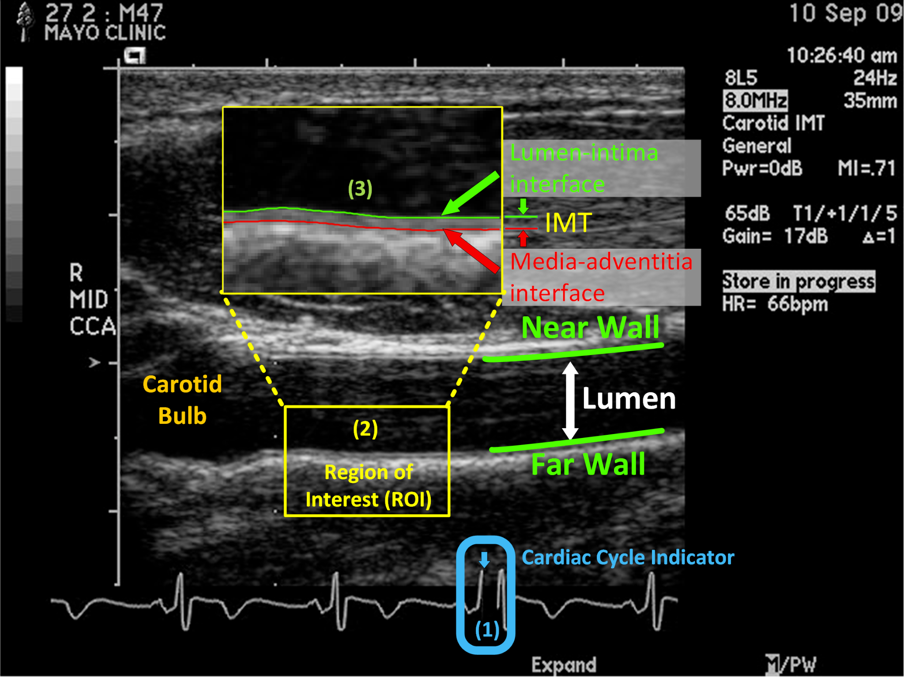
Layers of the Arterial Wall

Slide 6
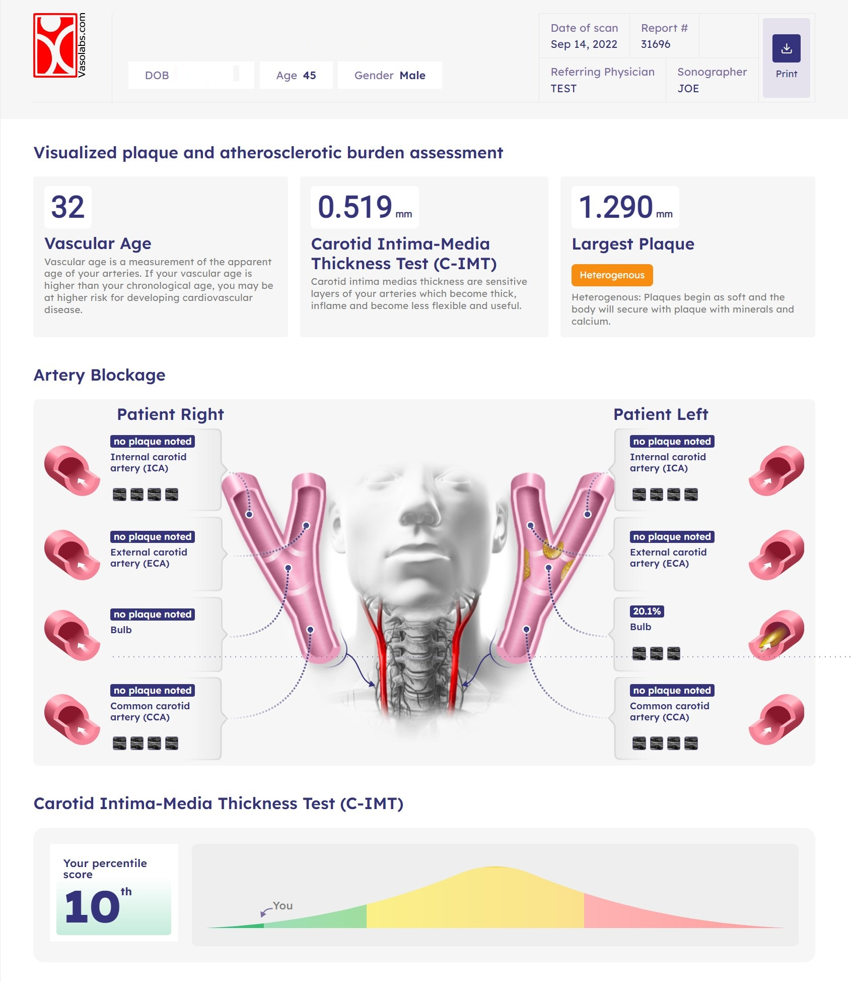
Vasometrics brings two diagnostic tools together.
Ultrasound technology lets us see inside the body. Modern ultrasound is very clear and the best images are in the Carotid artery above your shoulders.
Plaque = Atherosclerosis
Plaque can be seen in the arteries and this disease process is called atherosclerosis. Each plaque is measured and listed at the end of the report. The Largest Plaque (if any) is noted on the top right corner of the report.
Plaque found in Carotid correlates: similar size and consistency is found in the coronary tree. Confirmed with IVUS and Cadaver.

Slide 7
Built on HUGE Research Studies
Carotid IMT has been the preferred tool of use by the FDA to track inflammation. Vasolabs references the following research:
Inflammation = Arteriosclerosis
Inflammation can be seen and measured by looking at the Carotid Intima Media Thickness. When arterial layers get thick the artery is less flexible, this is arteriosclerosis. The C-IMT measurement is referenced to a large public database (ARIC) study, which derive your Vascular age, This same table is used to calculate the thickness of your artery related by percentile.
The ARIC study, Atherosclerosis Risk in Communities is where we get our IMT normative values. 400K study participants.

Slide 8
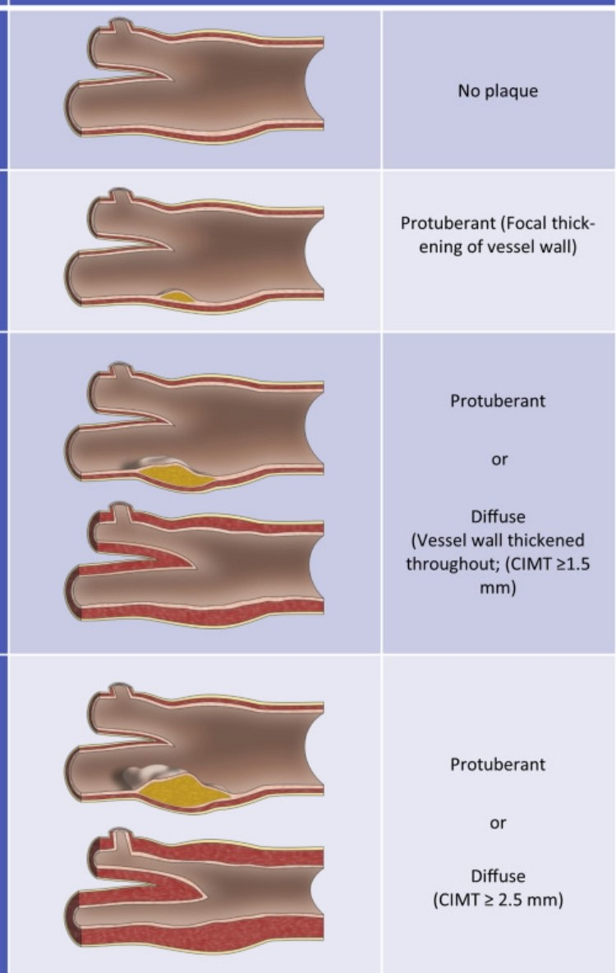
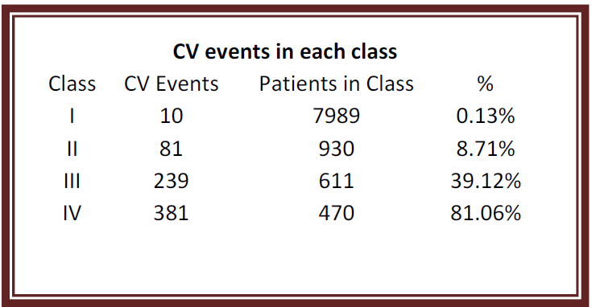
Caves Café Study
Plaque and Thick arteries: What are the statistics?
Population of ‘healthy’ patients (Problems with lipids, bp all booted)
CAVES CAFE study: 10K people over 10 years. Unhealthy patients excluded
Class IV Patients with an IMT >1mm = 81% chance of an event in the next 10 years.
Class III Patients with an IMT >1mm = 39% chance of an event in 10 years.

Slide 9
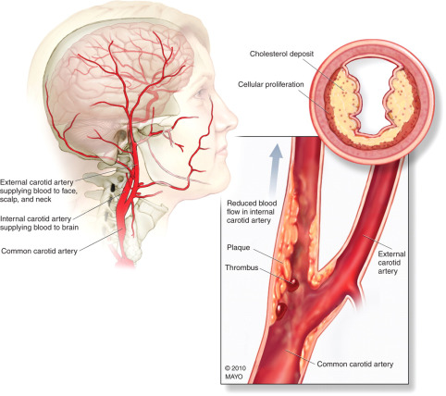
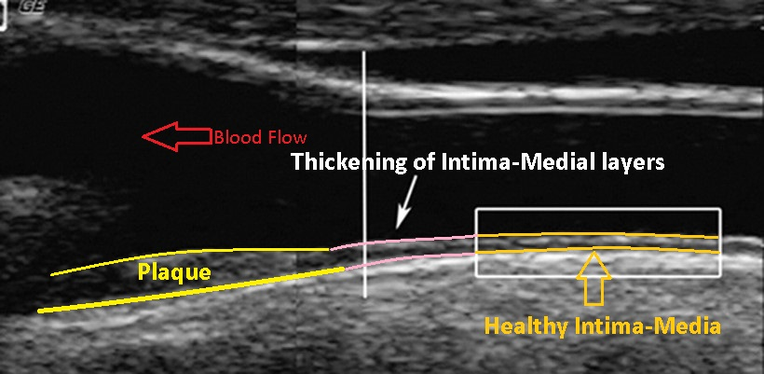
Carotid - IMT and Plaque are separate indicators.

Slide 10
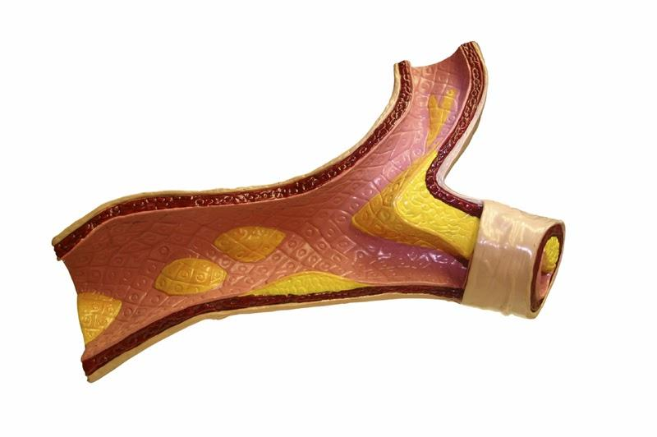
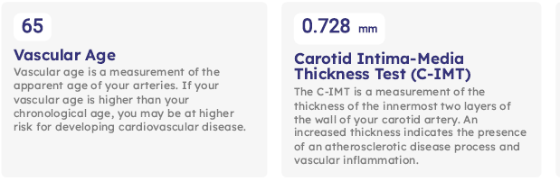
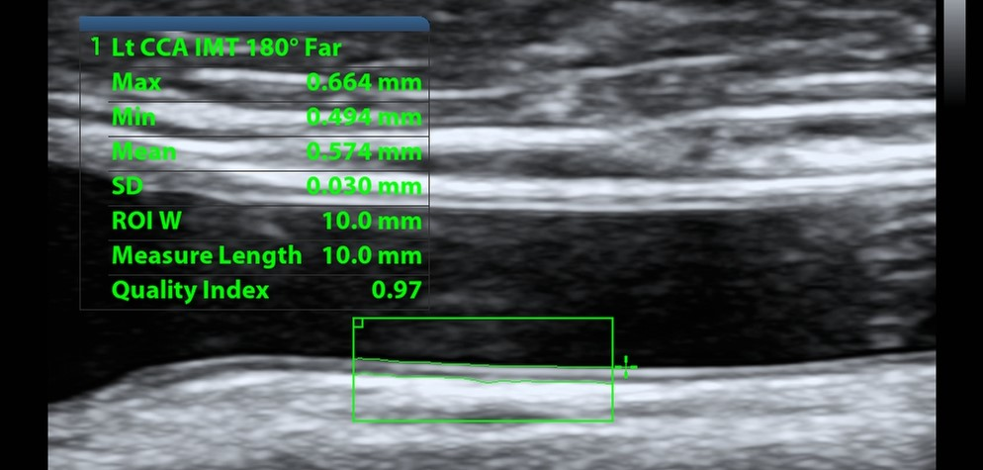
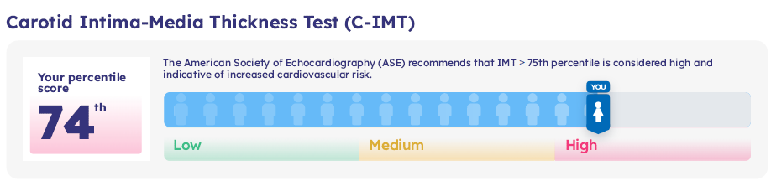
Vascular Age: How old are my arteries?
Vasometric report delivers an IMT measurement. Carotid IMT, Vascular Age and Percentile are all describing the same organ and measurement. The CIMT measurement (in mm) is compared to large research populations to calculate your vascular age and percentile. Vascular age changes slowly. Healthy habits are the most effective for improvement. Metabolic issues are the most common factor to improve.

Slide 11
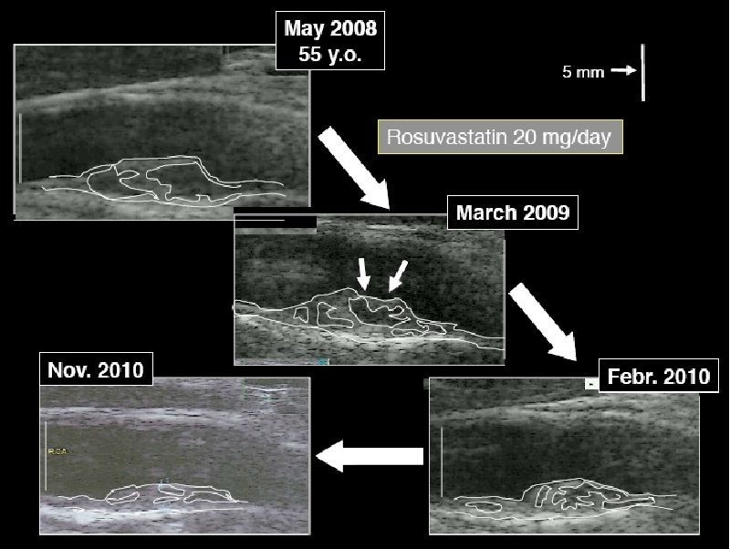
With good therapy, plaque will become secure.

Slide 12
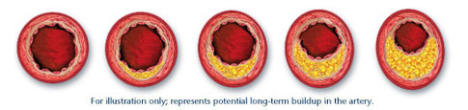
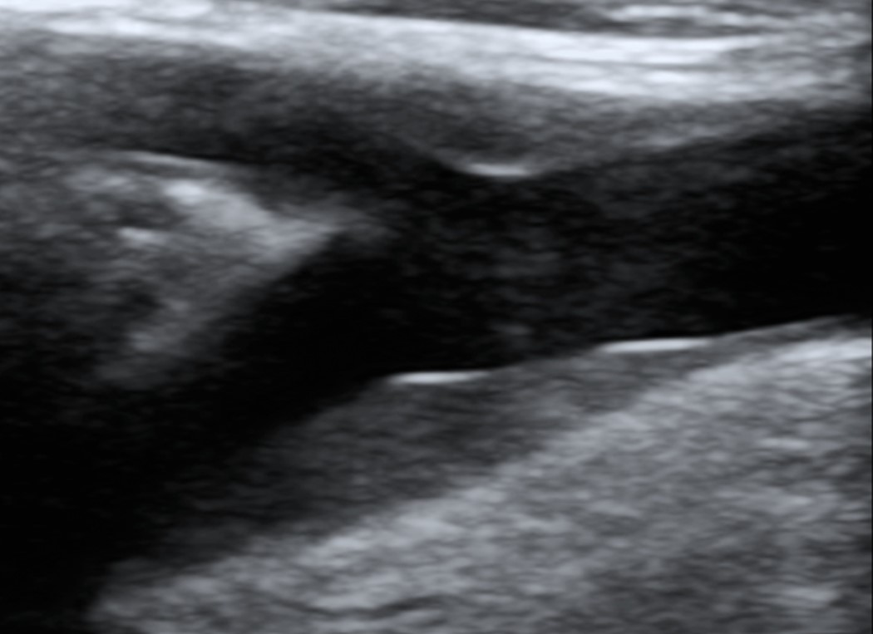
Would you make changes?
ARIC Study: Reference table for normative values: 10 People over 10 years
Atherosclerosis risk in communities.

Slide 13
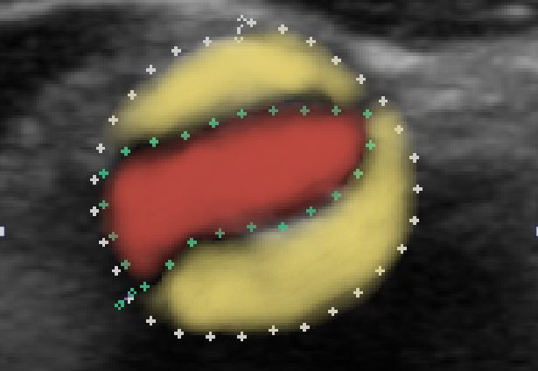
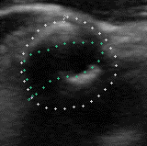
Vascular surgeon consult not recommended until 70%+ occlusion

Slide 14
Nattokinase and Serrapeptase
Nattokinase
Derived from natto, a traditional Japanese fermented soybean dish.
Celebrated in Japan for centuries, this enzyme is thought to help the body's natural ability to support cardiovascular health.
The fermentation process, which involves Bacillus subtilis natto, is believed to be crucial in producing Nattokinase, which may assist in the body's natural fibrinolytic activity – a process that can support the body's ability to manage blood clots and improve circulation.
Serrapeptase
Extracted from the bacteria Serratia E15 found in silkworm intestines
It is thought to aid the body in breaking down unwanted proteins.
Traditionally used in Europe and Asia, this enzyme is considered to potentially support the body's natural inflammatory response and may help in reducing discomfort associated with inflammation.
Combined with Vitamins D3 and K2

Slide 15
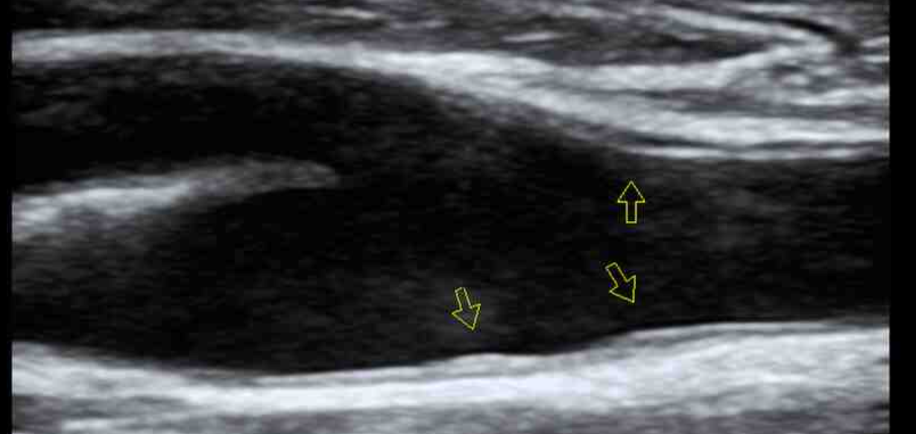
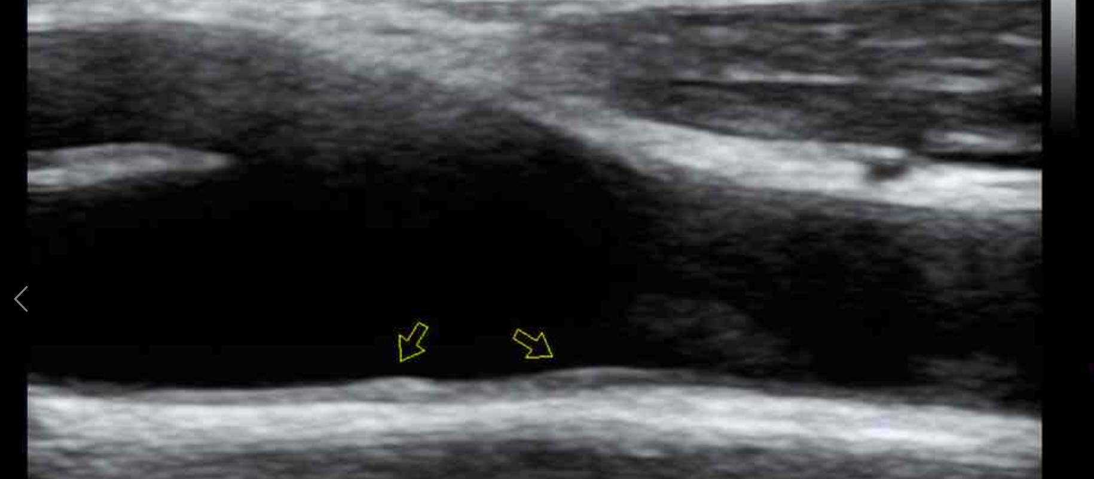
Nattokinase and Serrapeptase
May 2024
September 2024

Slide 16
Who is a good candidate for CIMT?
Over 40 years old
Family history of heart disease/stroke
Hyperlipidemia
High Cholesterol
Tobacco Use
High Blood Pressure
Diabetic
Metabolic diseases
Erectile dysfunction

